Slide 1

Mini Project Review
Sentiment Analysis of Amazon Customer Reviews.
Domain :- Machine learning
Mentor :- Mrs. Vidya Zope
Group Members :- 1) Paras Patil (D7B-41)
2) Kaustubh Keny (D7B-26)
3) Kapish Madhwani (D7B-32)
4) Vishesh Mittal (D7B-35)
Vivekanand Education Society’s Institute of Technology (Mumbai University)
Notes:
Vishesh

Slide 2
Index
Sr. No. | Topic | Slide No.
1 | Introduction for the project | 3-3
2 | Motivation for the project | 4-4
3 | Literature Survey | 5-12
4 | Problem Statement | 13-13
5 | Objectives | 14-14
6 | Requirements | 15-15
7 | Modular and Block Diagrams | 16-19
8 | Data Introduction | 20-20
9 | Methodology | 21-24
10 | Expected Output | 25-25
11 | Proposed Evaluation Measures | 26-26
12 | Conclusion | 27-27
13 | References | 28-29

Slide 3

Introduction For The Project
Our project is centered on Sentiment Analysis of Amazon Customer reviews. Sentimental analysis is the process of computationally identifying and categorizing opinions in a piece of text.
Furthermore, it focuses on classifying the polarities in user reviews using various Machine Learning Algorithms.
Notes:
Kaustubh

Slide 4

Motivation For The Project
The domain of NLP and its application is huge and there is an enormous amount of data on web applications where people are provided a platform to express their views, thus it becomes necessary to take benefit of it.
Machine learning is a booming industry and this motivated our group to explore something beyond the curriculum.
Our Group shares a mutual interest in the Machine Learning and App Development domain, so we decided to combine these two.
Notes:
Kaustubh

Slide 5
Literature Survey

Slide 6
Sr | Paper | Authors | Year | Summary | Advantages | Disadvantages
1 | Textual Dissection Of Live Twitter Reviews Using Naive Bayes | 1)Sourav.Kunal 2)Arijit Saha 3)Aman.Varma 4)Varma Vivek Tiwari | 2018 | This paper proposes the use of Tweepy and TextBlob as a python library to access and classify Tweets using Naïve Bayes. They developed an algorithm that takes the query as the person’s name for whom the user wants to calculate the percentage of positive & negative tweets. | 1)The live data capture is an excellent feature which takes care that all the data is up to date. 2) Using the pos_tagger makes it easier to use the lemmatizer. 3)TextBlob has a MIT License, is built on the top of NLTK and is very easily accessible. TextBlob is used for fast prototyping. On Comparing the Code Quality as calculated and provided by Lumnify, TextBlob is Level 3 and that of NLTK is Level 2. | 1)If there is a foreign category in test dataset, it will be assigned 0 probability. This can be rectified using smoothing techniques. 2)Multinomial Naive Bayes can handle and analyse this data with higher accuracy and efficiency. 3)They also used uni-gram method.

Slide 7
Sr | Paper | Authors | Year | Summary | Advantages | Disadvantages
2 | Sentimental Analysis of Twitter Data with respect to General Elections in India | 1)Ankita Sharma 2)Udayan Ghose | 2020 | In this paper, an efficient approach is proposed to analyze the sentiments of the twitter data.They used twitter for extraction of tweets 1.)Lexicon Based Approach for Sentiment Analysis it classifies words into 3 categories - positive,negative and neutral 2.)NRC Dictionary Based Approach it classify words Into 8 emotions along with negative and positive. They used Rapidminer and its Extension called AYL | 1.)Lexicon based approach requires scoring function to score each sentence and it has good accuracy on single phase. 2.)In NRC approach Since data is sentence sized, the positive and negative sentiment scores aren’t averaged to zero. | 1.)Rapidminer accuracy is less compared to VADER ( Valence Aware Dictionary for Sentiment Reasoning)[8] 2.)They used uni-grams which is less effective to catch sarcasm.

Slide 8
Sr | Paper | Authors | Year | Summary | Advantages | Disadvantages
3 | Sentiment analysis of social media Twitter with case of Anti-LGBT campaign in Indonesia using Naive Bayes, Decision Tree & Random Firest Algorithm. | 1)Veny Amilia Fitri 2)Rachmadita Andreswari 3)Muhammad Azani Hasibuan | 2019 | This paper presents the usage of different classifier algorithms to analyse the sentiment associated with Anti-LGBT. It used twitter as a source of data to feed to the algorithms. Based on parameters like recall, precision, F1-measure, it was concluded that Naive Bayes had the highest accuracy (86.43%) compared to rest (~82%). After analysis of data, the resultant major tendency for comments was found to be neutral. | 1)A detailed comparative study between Random Forest, Naive Bayes and Decision Tree was made. 2)Naive Bayes can easily provide high accuracy in case of sentence sized data like tweets. | 1)The number of models compared is low. 2)Naive Bayes assumes all features to be independent. This will reduce accuracy when collinearity is to be considered.

Slide 9
Sr | Paper | Authors | Year | Summary | Advantages | Disadvantages
4 | Text Classification using Different Feature Extraction Approaches. | 1)Robert Dzisevic 2)Dmitrij Sesok | 2019 | In this paper, three different text feature extraction dimensionality reduction approaches based on TF-IDF were applied for classification using keras. The TF-IDF LSA approach outperformed the plain TF-IDF by 1% for small datasets while the plain TF-IDF gave higher accuracy (91%) for larger datasets. The TF-IDF LDA approach failed to reduce the noise in data in both cases which ended up reducing the accuracy. | 1)Overfitting of TF-IDF model is prevented with LSA and LDA enhancements which can become very apparent in very large data-sets. 2)The calculations involved in TF-IDF are very easy. | 1) If a word occurs in every element of data-set, TF-IDF will assign it a 0 weightage thus, those words become irrelevant to other corpus terms. 2)The extraction time with TF-IDF increases exponentially with increase in document size.

Slide 10
Sr | Paper | Authors | Year | Summary | Advantages | Disadvantages
5 | Sentimental Short Sentences Classiﬁcation by Using CNN Deep Learning Model with Fine Tuned Word2Vec | 1)Amit Kumar Sharma, 2)Sandeep Chaurasia 3)Devesh Kumar Srivastava | 2019 | This paper provides sentimental summarization of short sentences. Movie review corpus(imdb) was used. There search is giving a better accurate result for feature extraction through Word2Vec and CNN methods for small sentences of movie review corpus. The proposed model is providing 99.07% accuracy for training samples and 82.19% for testing samples. | 1)The CNN model provides better and more accurate results as compared to NB and ELM models. 2) The proposed model is better for learning local features from phrases or words. | 1)Occurence of multilingual content in the dataset leads to low sentimental results. 2)The model lacks in accuracy for sequential data (long sentences) 3) Social media databases are big and susceptible to noisy, incomplete, and inconsistent text due to their origin from diﬀerent people and sources.

Slide 11
Sr | Paper | Authors | Year | Summary | Advantages | Disadvantages
6 | Constructing a heterogeneous training dataset for Emotion Classification | 1)Anchal Gupta 2)Satish Mahadevan Srinivasan | 2019 | This paper presents a dataset for twitter sentiment analysis by using 6 models and compares their F1 Accuracy . In this paper they have used lexicon based NRC classifiers for different emotions such as joyful , sad , angry and surprise. | 1) Deep Neural network showed a mediocre performance compared to other models , but these models did not overfit. | 1) Models like RF performed good on testing data but performed poorly on training data set due to overfitting.

Slide 12
Sr | Paper | Authors | Year | Summary | Advantages | Disadvantages
7 | String-based Multinomial Naïve Bayes for Emotion Detection among Facebook Diabetes Community. | 1)Vimala Balakrishnan 2)Wandeep Kaur | 2019 | This paper determined the emotions among the online Diabetes community on Facebook . The emotions were classified according to Plutchik's wheel of emotions , comprising of 8 emotions fear, joy ,anger , sadness, surprise , trust , anticipation and disgust. It used 4 classifiers and their accuracy was compared . | 1) String - based Multinomial Naive Bayes classifier outperformed every other classifier used for particular data set. | 1) The biggest drawback of MNB is that if it comes across any category that didn’t exist in training data set , it will not be able to predict the output, as the probability of that category was assigned to zero.

Slide 13

Problem statement
We are performing the sentiment analysis of Amazon product reviews after text classification using various Machine Learning algorithms .
We will test and compare a number of supervised models to determine which is the best suited for our purpose.
As of now, we are going to use algorithms such as SVM, Decision Tree and different types of Naive Bayes in supervised learning domain.
Notes:
Kapish

Slide 14

Objectives
To understand various aspects of different algorithms and thus, compare them qualitatively as well as quantitatively.
To perform sentiment analysis of Amazon product reviews and determine the overall consumer polarity.
To deploy an application to demonstrate sentiment analysis.
Notes:
Paras

Slide 15

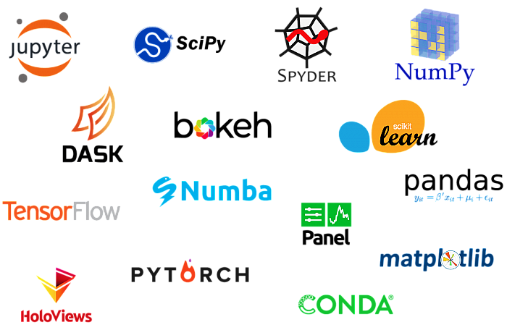
Requirements
Hardware -
HP Pavilion-15 laptop with an Intel core i5 9th gen processor upto 4.1 GHz and GTX 1050 ti mobile graphics card.
HP Pavilion-15 laptop with a Ryzen 5 3rd gen processor upto 4.2 GHz and GTX 1650 mobile graphics card.
Software -
Jupyter Notebook, Python, Anaconda & its libraries.
GitHub.
Android Studio, Flutter.
More requirements will be added as the project progresses.
Notes:
Vishesh

Slide 16
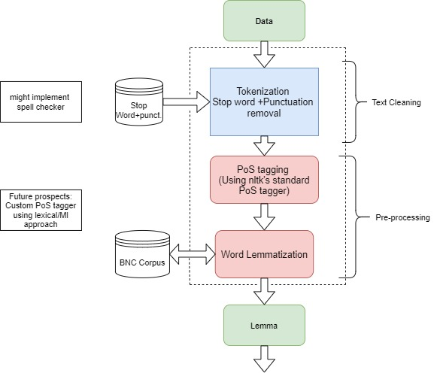
Text-Cleaning

Slide 17
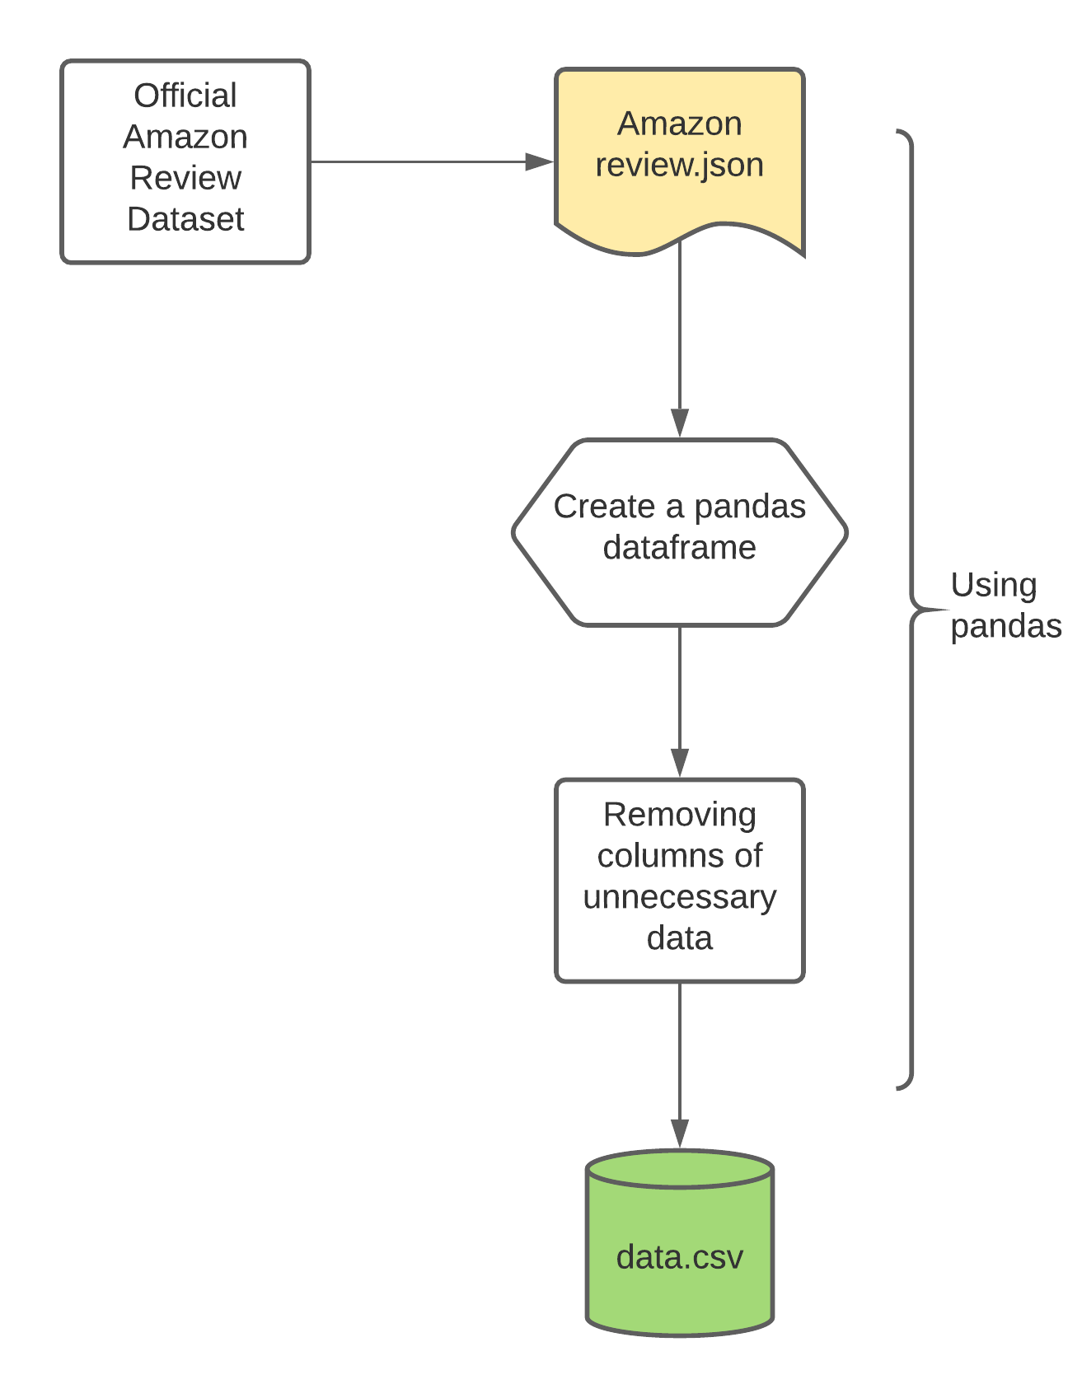
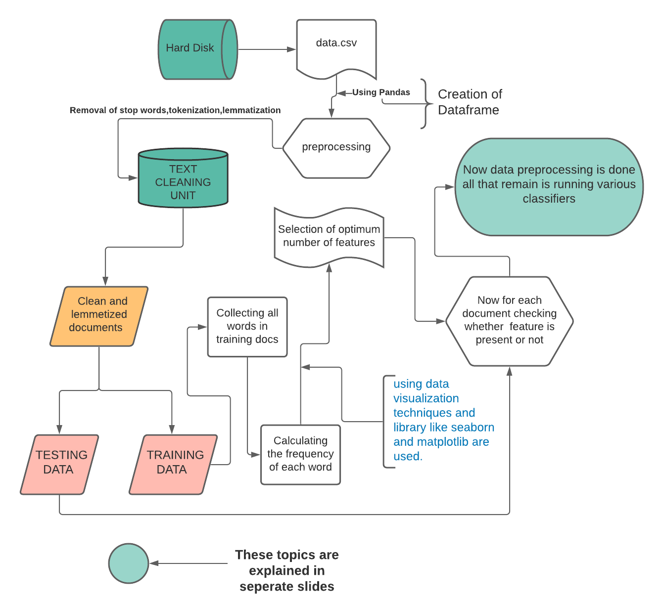
Analysis Unit (True/False Based)

Slide 18
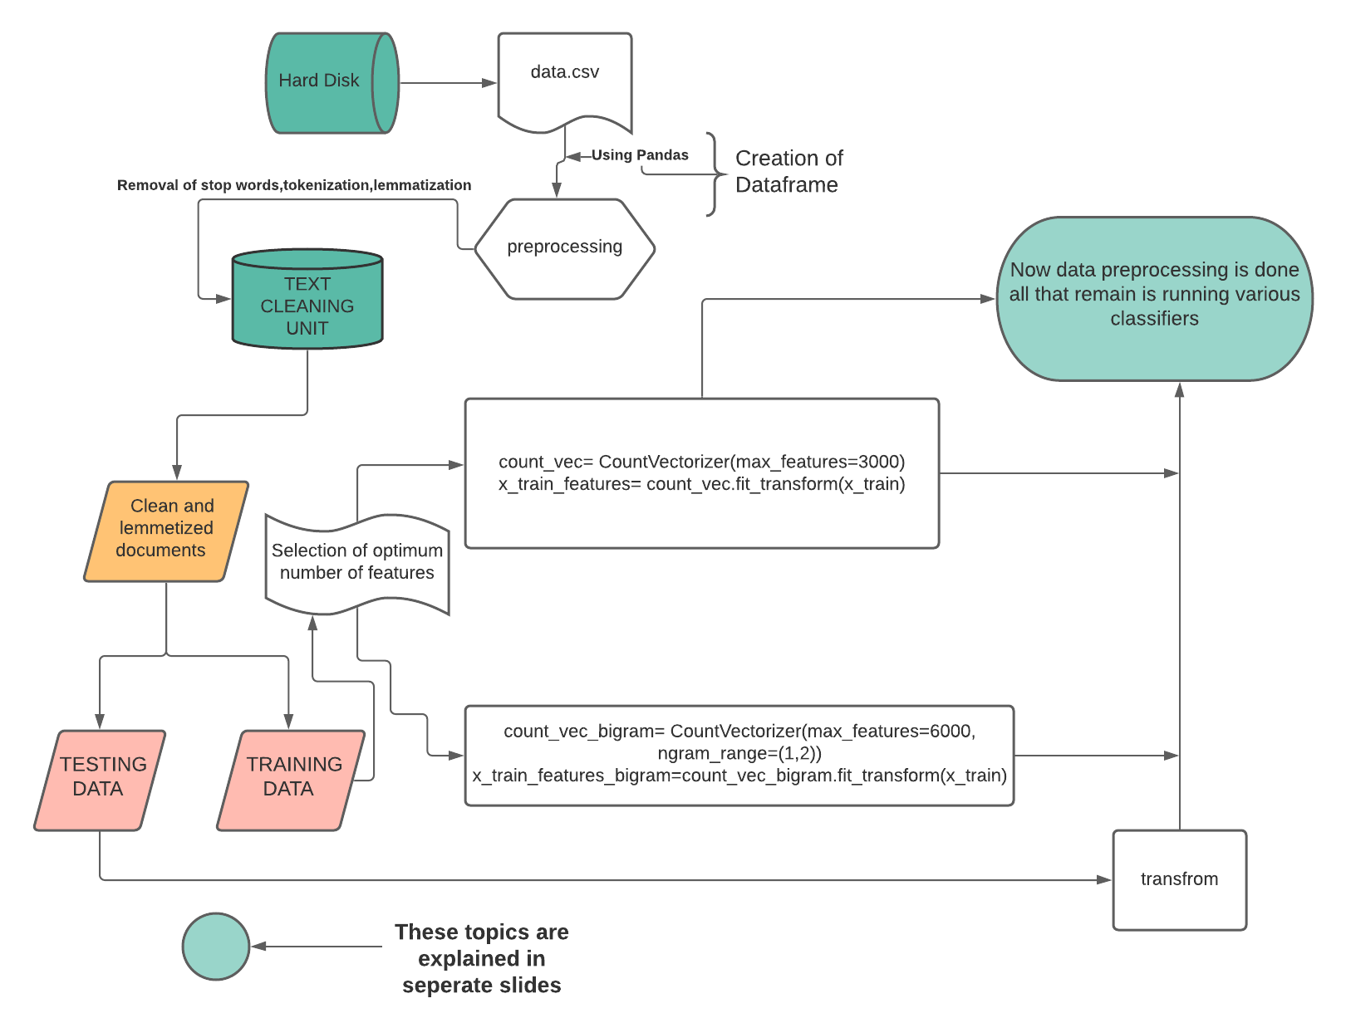
Analysis Unit
(Count Vectorized Based)

Slide 19
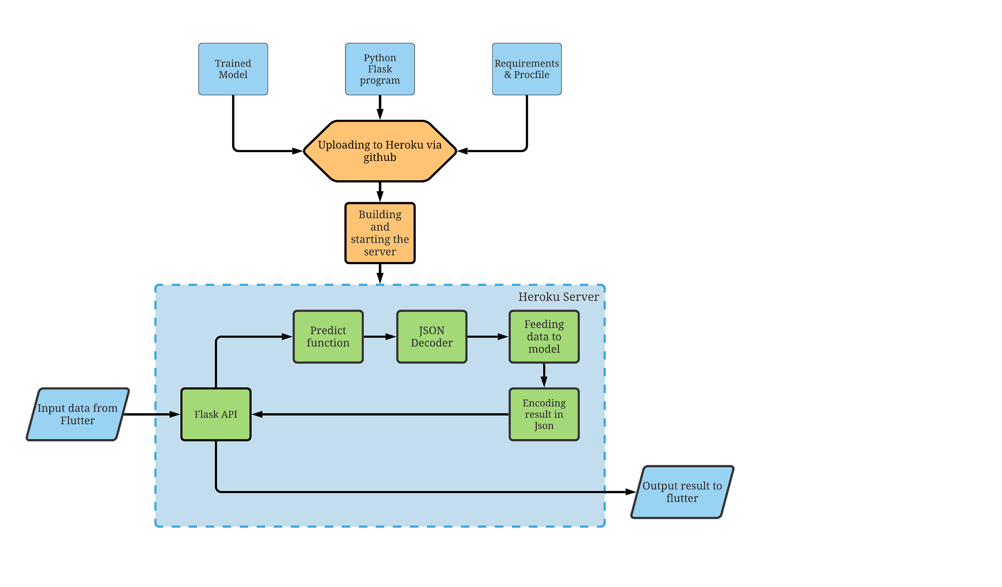
Flutter Integration via API

Slide 20
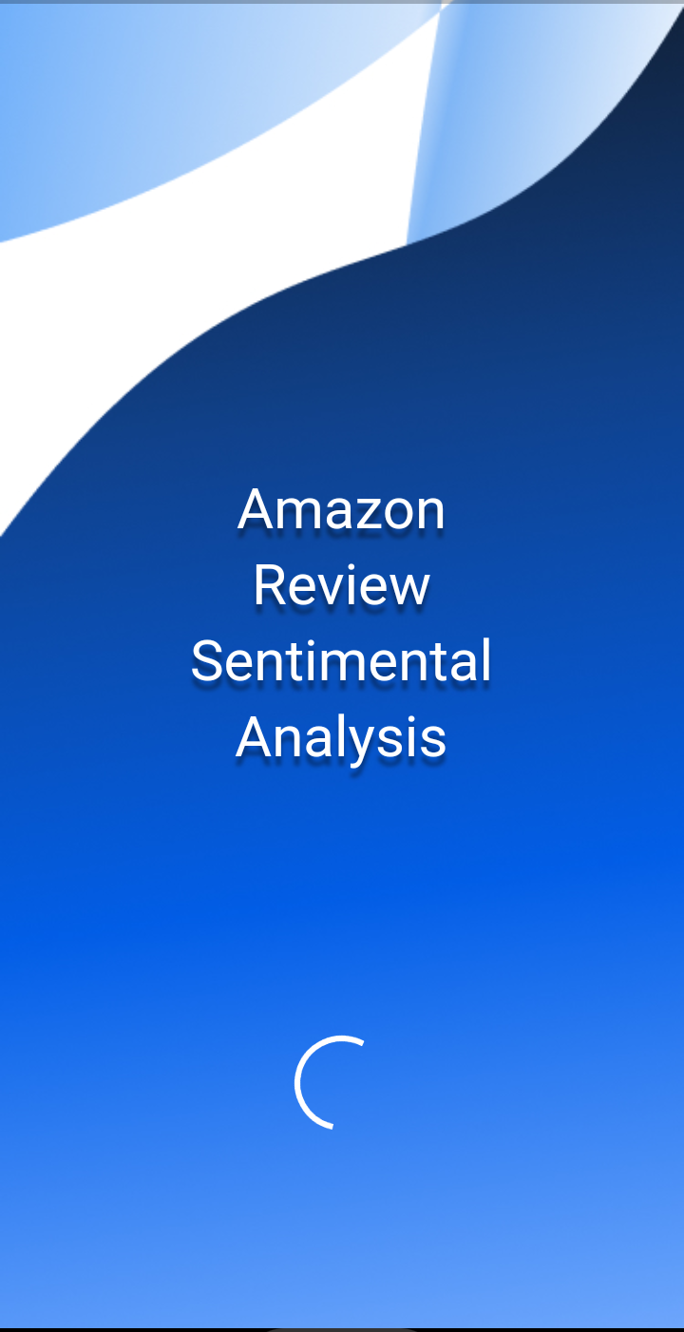
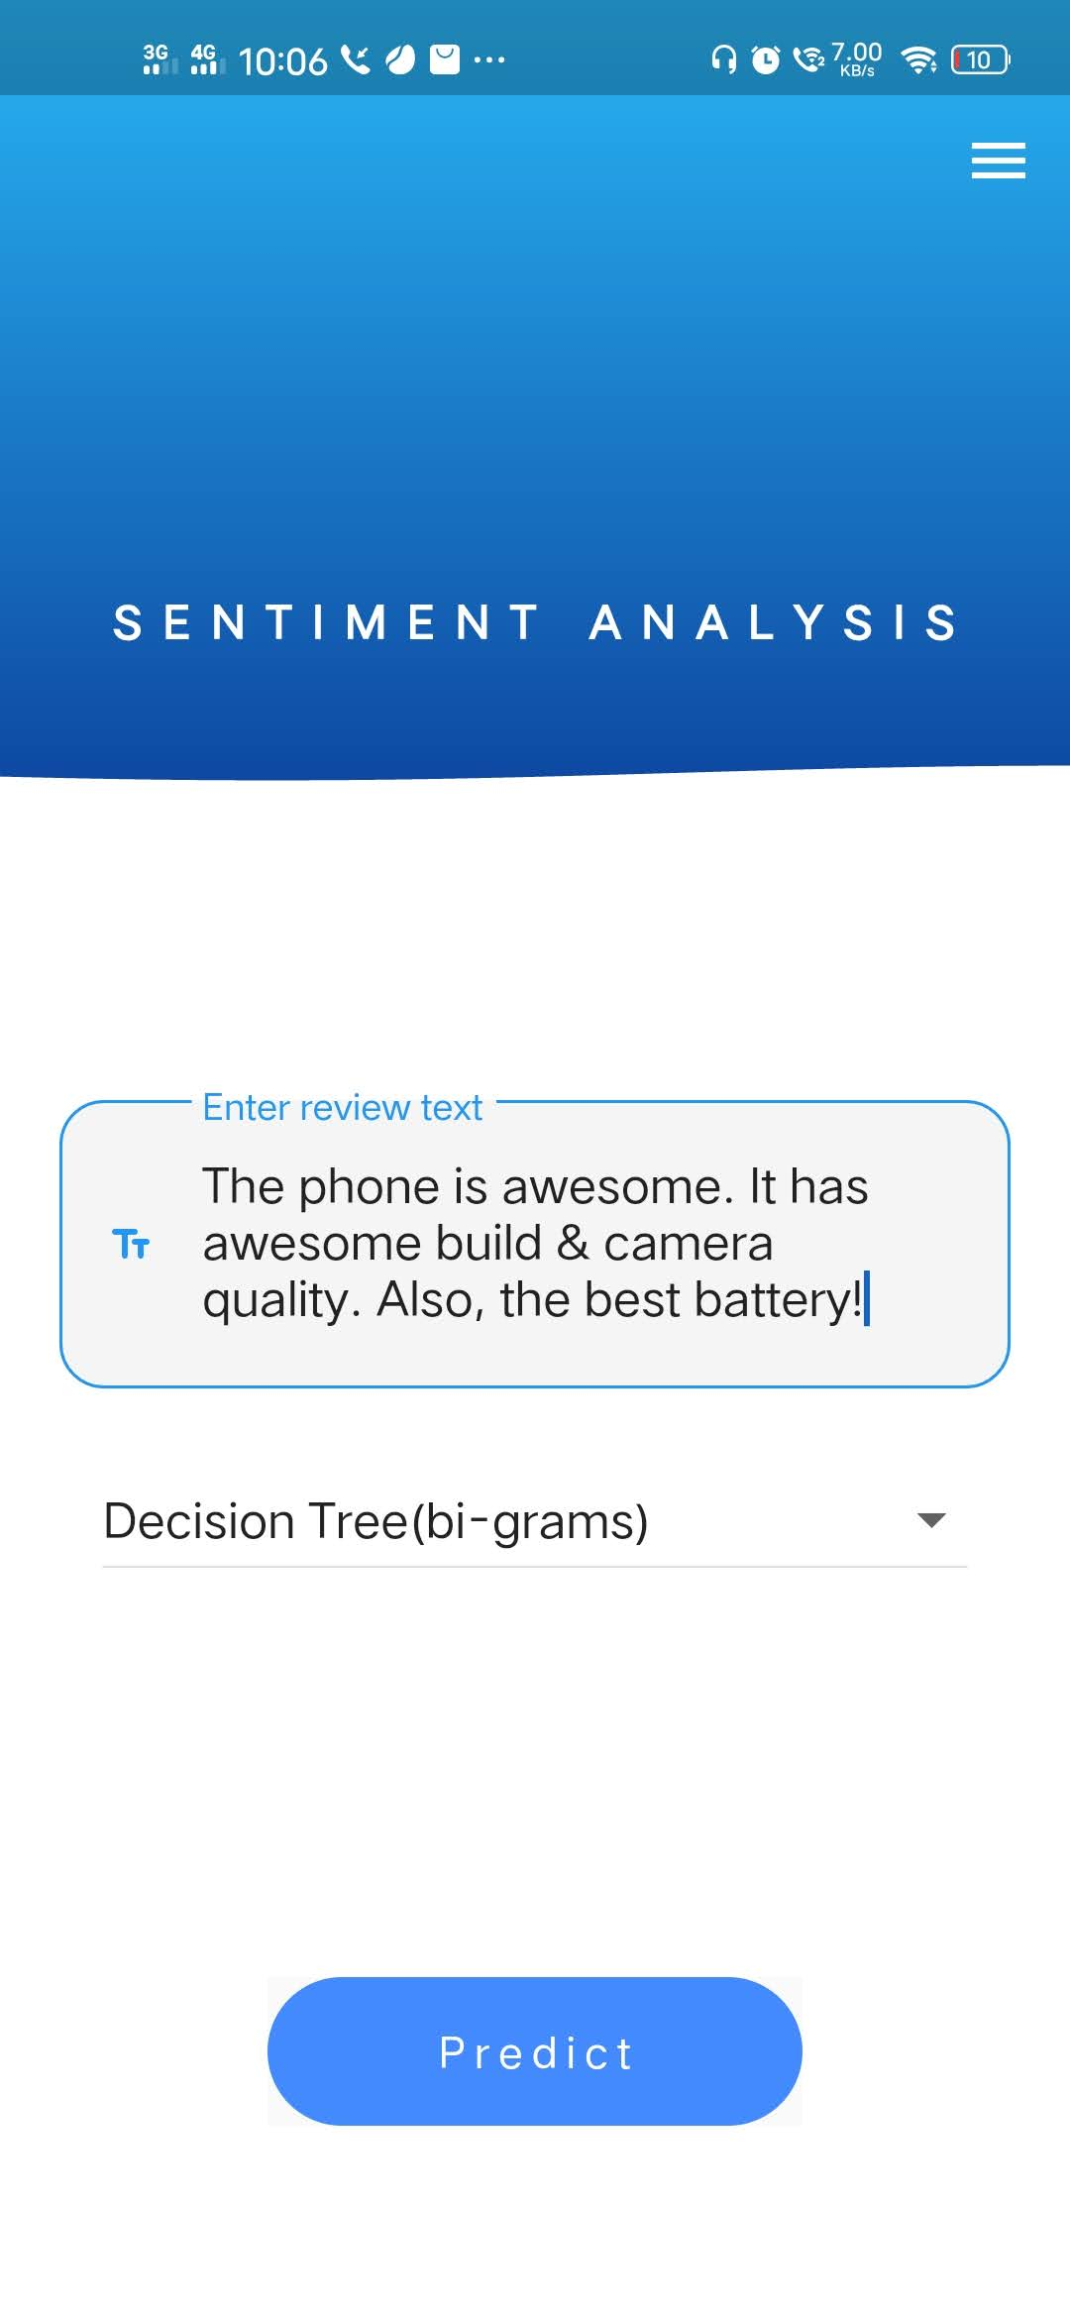
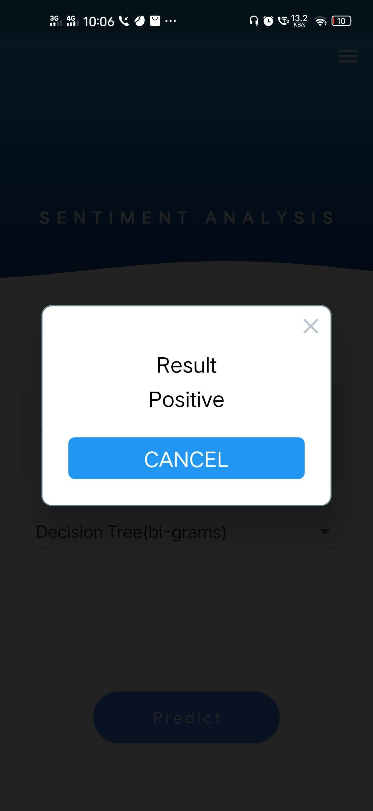
Loading Page Home Page Result

Slide 21
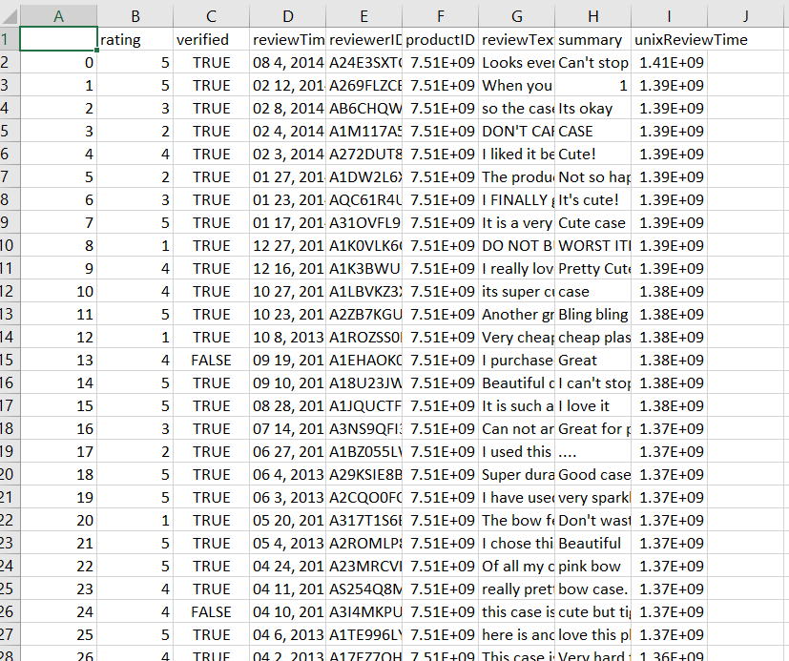
Data Introduction
RevieweD - ID of the reviewer, e.g. A2SUAM1J3GNN3B
asin - ID of the product, e.g. 0000013714
review Text - text of the review
summary - summary of the review
unix Review Time - time of the review (unix time)
review Time - time of the review (raw)
image - images that users post after they have received the product
The dataset is from Amazon Review Data (2018):https://nijianmo.github.io/amazon/index.html
Notes:
Kapish

Slide 22
Methodology

Slide 23
Methodology for Text Cleansing
A) Tokenization and Stop word removal: These tasks are doing using standard python libraries. However ,a separate dataset of stop words was created for stop word removal. The final list of clean words will be fed into the POS tagger.
B) POS tagger: During the initial time of our research, we sought to implement python nltk’s pre-trained PoS taggers. However for optimisation of PoS tagging with respect to our Customer Review Dataset, we plan to implement a separate PoS tagger. There are two approaches for this:
1) Treating the dataset as a classification problem where given a word and features like previous word,context and so on to classify the given word into a PoS category.
2) While other approach try to model it as a generative model using similar features.
C) Lemmatizer: Lemmatizing is the process of obtaining base word(lemma) from a word based on its part_of_speech. Our team has utilized an open source corpus , the British National Corpus(BNC) for creating the Lemmatizer. We further created an annotated dataset (tagged corpus) to provide the lemma for each word. Basically it is a huge list of words and their related lemma for each PoS.

Slide 24
Methodology for Model Selection and Future Scope
MODELS GOALS | SUPERVISED MODELS: | UNSUPERVISED MODELS:
THIS ROW IS SOMETHING FOR SURE WE ARE GOING TO IMPLEMENT. | We are implementing inbuilt models as of now,mainly various types of Models in sklearn and nltk. | We are using LSTM model which is inside keras which is a high level API and is integrated as a part of Tensorflow 2.0
THIS ROW IS US BEING NAIVE AND HOPING TO IMPLEMENT. | We are optimistic to build a multinomial naive bayes(MNB) and KNN model from the very scratch and compare its accuracy with inbuilt models. | We are hoping to increase its accuracy by a significant amount by using some manual methods and better optimized text cleaning based on different ml models in accordance with the used dataset.

Slide 25
Methodology For Integrating App with ML Model
The trained model, API ( python flask) & other requirements are uploaded to Heroku server. The user supplies the input data from flutter interface which sends it as a query to API on server using http dependency after Analyze button is pressed.
This also invokes the ‘/predict’ app route where data is fed to the model imported into flask API via ‘pickle library’. The model predicts a result which is converted into json before sending to the server. The ‘http’ dependency has a Response class that stores the responses received from http ‘GET’ function.
The json format received from the API is decoded in flutter using ‘convert’ dependency. The result of this decoding is shown as predicted output to the user.

Slide 26

Expected Output
Based on reference of research papers -
In Supervised Machine learning algorithms, Multinomial Naive Bayes will outperform its counterparts.
DT, SVM and Multinomial Naive Bayes will provide similar accuracy.
Deep learning models like LSTM however, should outperform these Machine Learning algorithms by a considerable margin.
Notes:
Paras

Slide 27

Proposed
Evaluation
Measures
Depth of comparison between different algorithms while selection phase.
Accuracy of trained model.
Response time of the program.
Deployment of model via mobile application.
System Requirements for execution of application.

Slide 28
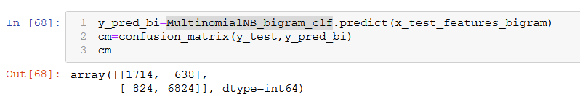
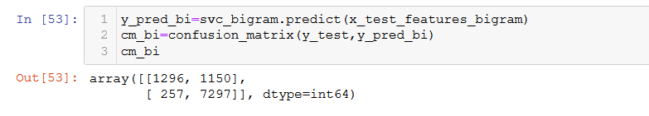
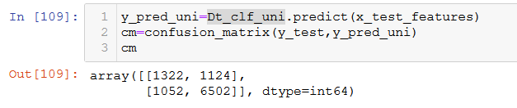
Confusion Matrices:
MNB(bi-grams)
SVC(bi-grams)
DT(uni-grams)
Notes:
Vishesh

Slide 29
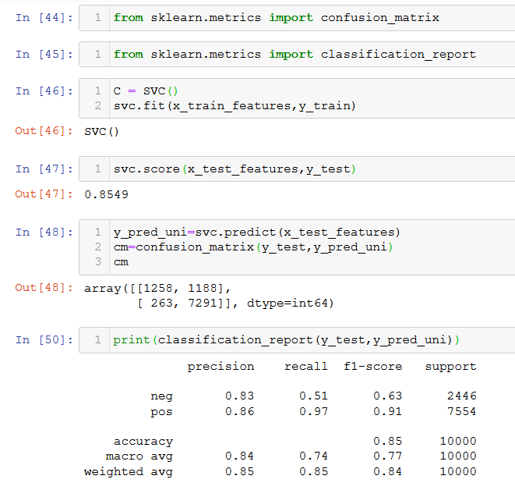
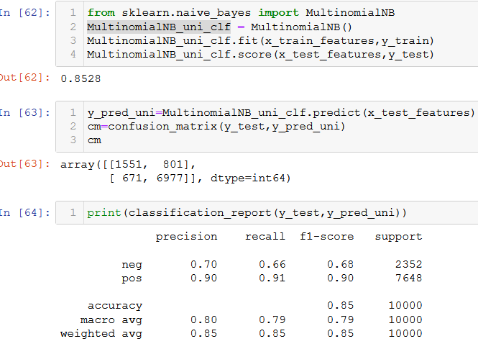
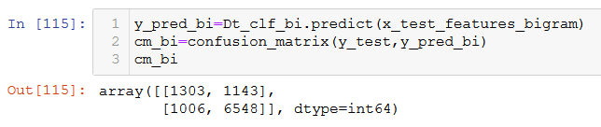
Confusion Matrices:
SVC(uni-grams)
MNB(uni-grams)
DT(bi-grams)

Slide 30
Experiment & Result:
Accuracy: the percentage of texts that were categorized with the correct tag.
Precision: the percentage of examples the classifier got right out of the total number of examples that it predicted for a given tag.
Recall: the percentage of examples the classifier predicted for a given tag out of the total number of examples it should have predicted for that given tag.
F1 Score: the harmonic mean of precision and recall.
Notes:
Vishesh

Slide 31
SVM(uni-grams)
Model |  | Precision | Recall | F1-score | Support
SVM (uni-grams) | neg | 0.83 | 0.51 | 0.63 | 2446
 | pos | 0.86 | 0.97 | 0.91 | 7554
 | accuracy | 0.85 |  |  | 10000
 | macro avg | 0.84 | 0.74 | 0.77 | 10000
 | weighted avg | 0.85 | 0.85 | 0.84 | 10000

Slide 32
SVM(bi-grams)
Model |  | Precision | Recall | F1-score | Support
SVM (bi-grams) | neg | 0.83 | 0.53 | 0.65 | 2446
 | pos | 0.86 | 0.97 | 0.91 | 7554
 | accuracy | 0.86 |  |  | 10000
 | macro avg | 0.85 | 0.75 | 0.78 | 10000
 | weighted avg | 0.86 | 0.86 | 0.85 | 10000

Slide 33
DT(uni-grams)
Model |  | Precision | Recall | F1-score | Support
DT (uni-grams) | neg | 0.56 | 0.54 | 0.55 | 2446
 | pos | 0.85 | 0.86 | 0.86 | 7554
 | accuracy | 0.78 |  |  | 10000
 | macro avg | 0.70 | 0.70 | 0.70 | 10000
 | weighted avg | 0.78 | 0.78 | 0.78 | 10000

Slide 34
DT(bi-grams)
Model |  | Precision | Recall | F1-score | Support
DT (bi-grams) | neg | 0.56 | 0.54 | 0.55 | 2446
 | pos | 0.85 | 0.86 | 0.86 | 7554
 | accuracy | 0.79 |  |  | 10000
 | macro avg | 0.71 | 0.70 | 0.70 | 10000
 | weighted avg | 0.78 | 0.79 | 0.78 | 10000

Slide 35
MNB(uni-grams)
Model |  | Precision | Recall | F1-score | Support
MNB (uni-grams) | neg | 0.70 | 0.66 | 0.68 | 2352
 | pos | 0.90 | 0.91 | 0.90 | 7648
 | accuracy | 0.85 |  |  | 10000
 | macro avg | 0.80 | 0.79 | 0.79 | 10000
 | weighted avg | 0.85 | 0.85 | 0.85 | 10000

Slide 36
MNB(bi-grams)
Model |  | Precision | Recall | F1-score | Support
MNB (bi-grams) | neg | 0.68 | 0.73 | 0.70 | 2352
 | pos | 0.90 | 0.91 | 0.90 | 7648
 | accuracy | 0.85 |  |  | 10000
 | macro avg | 0.79 | 0.81 | 0.80 | 10000
 | weighted avg | 0.86 | 0.85 | 0.85 | 10000

Slide 37
Conclusion
After research, we can conclude that -
It was observed that DT has the lowest scores (0.78) while the rest of the models had a similar accuracy (0.86 - 0.87).
Bigram models outperformed Unigram ones by 1-2% while most CV Models being able to catch a little bit of sarcasm.
However, in live testing it was seen that DT performs on par with SVM while the NLTK based Bernoulli’s NB displayed the worst results.
Selection of appropriate Machine Learning models is essential.
Tedious data cleaning processes can be automated and optimised using ML models, feature reduction, etc.
Python can be integrated along with flutter using Flask API which makes it easy to deploy ML models for public use via mobile applications.
Notes:
Paras

Slide 38
References
[5]Sourav Kunal, Arijit Saha, Aman Varma, Vivek Tiwari , International Conference on Computational Intelligence and Data Science (ICCIDS 2018), “Textual Dissection Of Live Twitter Reviews Using Naive Bayes”,Procedia Computer Science Volume 132, Pages 307-313,2018
[6] Veny Amilia Fitri, Rachmadita Andreshwari and Muhammad Azani Hasibuan, “Sentiment analysis of social media Twitter with case of Anti-LGBT campaign in Indonesia using Naive Bayes, Decision Tree & Random Firest Algorithm,” The Fifth Information Systems International Conference 2019, Procedia Computer Science, vol 161, pp. 765–772, 2019.
[7]Robert Dzisevič and Dmitrij Šešok, “ Text Classification using Different Feature Extraction Approaches,” 2019 Open Conference of Electrical, Electronic and Information Sciences, 25-25 April 2019.
[8] Anton Borg and Martin Boldt., “Using VADER Sentiment and SVM for Predicting Customer Response Sentiment,” Expert Systems with Applications, 2020.

Slide 39
References
[1] Vimala Balakrishnan & Wandeep Kaur , 23rd International Conference on Knowledge-Based and Intelligent Information & Engineering Systems , “String-based Multinomial Naïve Bayes for Emotion Detection among Facebook Diabetes Community.” Procedia Computer science , 159 , pp.30-37 (2019).
[2] Anchal Gupta and Satish Mahadevan Srinivasan , The Fifth Information Systems International Conference 2019 “Constructing a heterogeneous training dataset for Emotion Classification.” Procedia Computer Science , 161 , pp. 765-772 (2019)
[3] Amit Sharma ,Sandeep Chaurasia and Devesh Kumar Shrivastava, International Conference on Computational Intelligence and Data Science (ICCIDS 2019), ”Sentimental Short Sentences Classification by Using CNN DeepLearning Model with Fine Tuned Word2Vec.”,Procedia Computer Science 167, pp.1139-1147,2020.
[4] Ankita Sharma, Udayan Ghose ,International Conference on Smart Sustainable Intelligent Computing and Applications under ICITETM2020 , “Sentimental Analysis of Twitter Data with respect to General Elections in India” Procedia Computer Science Volume 173 , Pages 325-334 , 2020

Slide 40
THANK YOU !

